Slide 1
Data Engineering
Lecture 2

Slide 2
Lecture Agenda
What is big-data?
History of cloud computing
Types of clouds
Data-engineering
Python libraries for data science and cloud computing

Slide 3
What is Big Data?
Big data is a collection of large datasets that cannot be processed using traditional computing techniques. It is not a single technique or a tool.
Benefits
Using the information kept in the social network like Facebook, twitter, etc.
Using the information in the social media like preferences and product perception of their consumers.

Slide 4
Sources of Big Data
Social networking sites: Facebook, Google, LinkedIn
E-commerce site: Amazon, Flipkart, Alibaba
Weather Station: All the weather station and satellite gives very huge data which are stored and manipulated to forecast weather
Telecom company: Airtel, Vodafone
Share Market: Stock exchange across the world

Slide 5
3V's of Big Data
Velocity: The data is increasing at a very fast rate. It is estimated that the volume of data will double in every 2 years.
Variety: Data is structured as well as unstructured.
structured – predefined schema
unstructured – each document has different properties
Volume: The amount of data which we deal with is of very large size of Peta bytes.
(1 Peta = 1024 TB)

Slide 6
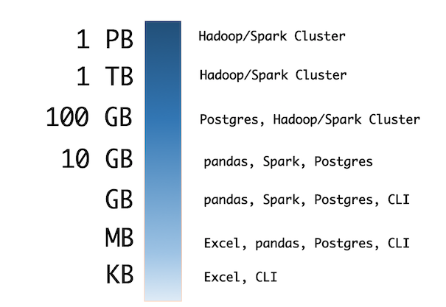
Handling Big Data
Excel
Pandas – Lecture 3
Hadoop – Lectures 4,5
Spark – Lectures 6,7
Streaming – Lectures 10,11

Slide 7
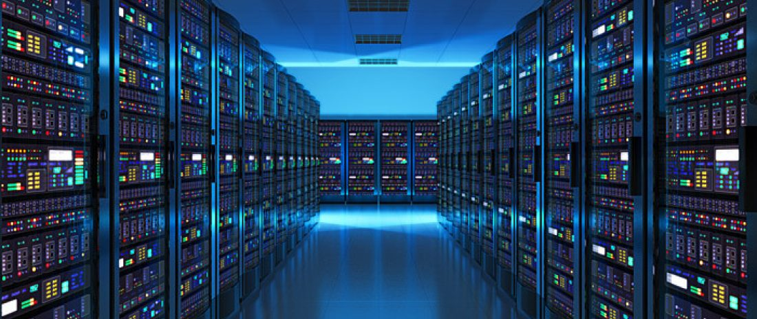
What is Cloud?
Datacenter hardware and software that the vendors use to offer the
computing resources and services.

Slide 8
Cloud Computing
Represents both the cloud & the provided services
Why call it “cloud computing”?
Some say because the computing happens out there "in the clouds” ☺
Wikipedia: "the term derives from the fact that most technology diagrams depict the Internet or IP availability by using a drawing of a cloud."

Slide 9
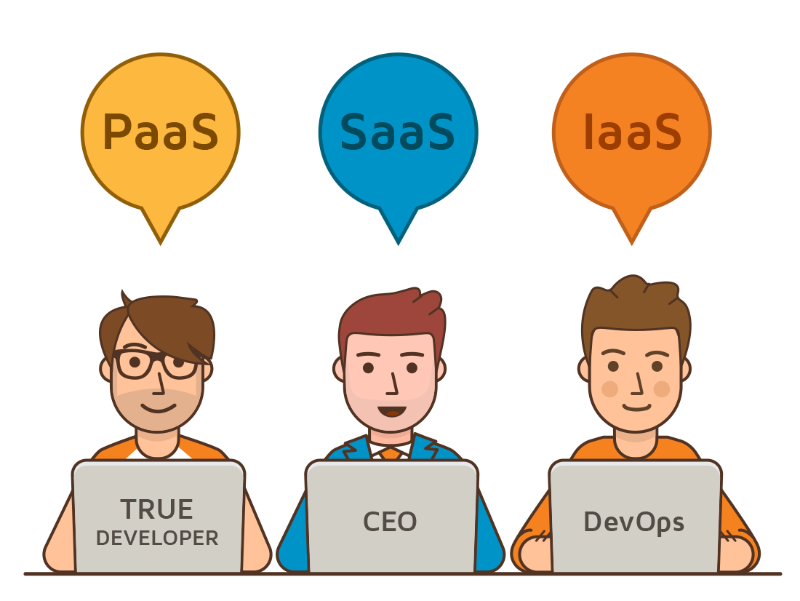
Cloud Computing Services
Software as a Service (SaaS) – applications though the browser
Platform as a Service (PaaS) - Delivery of a computing platform for custom software development as a service
Infrastructure as a Service (IaaS) - Deliver of computer infrastructure as a service
And more ..

Slide 10
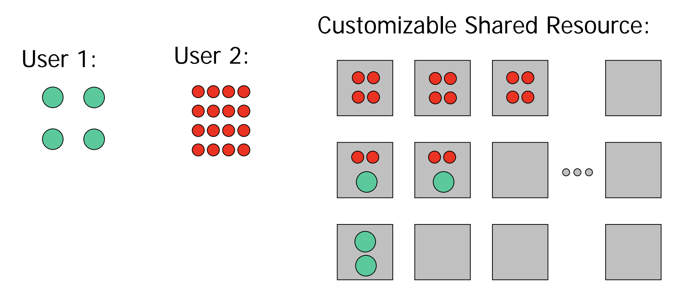
Resource Sharing
Offering computing resources as a service or utility through virtualization

Slide 11
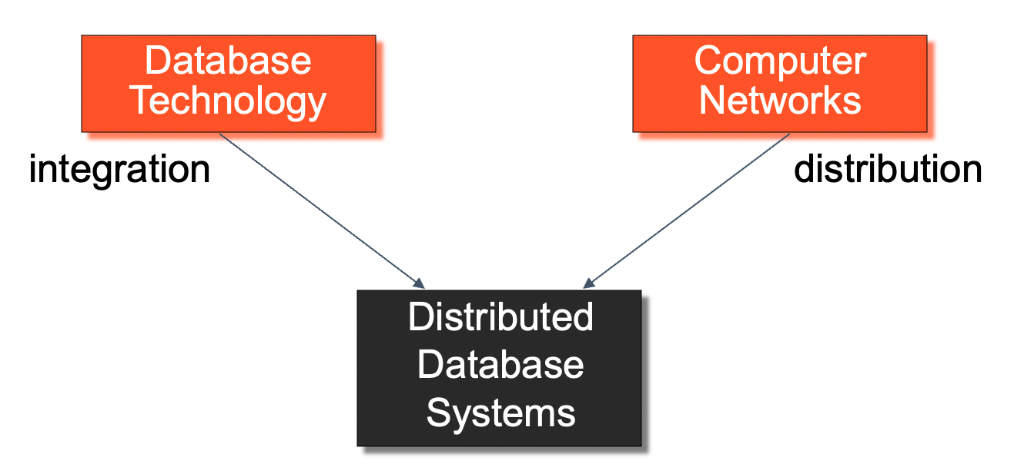
Distributed Computing
Multiple processing elements that are interconnected by a computer network and that cooperate in performing their assigned tasks.
What is being distributed? Processing logic, Function, Data, Control

Slide 12
Distributed Database System
A distributed database (DDB) is a collection of multiple, logically interrelated databases distributed over a computer network. A distributed database management system (D–DBMS) is the software that manages the DDB and provides an access mechanism that makes this distribution transparent to the users.

Slide 13
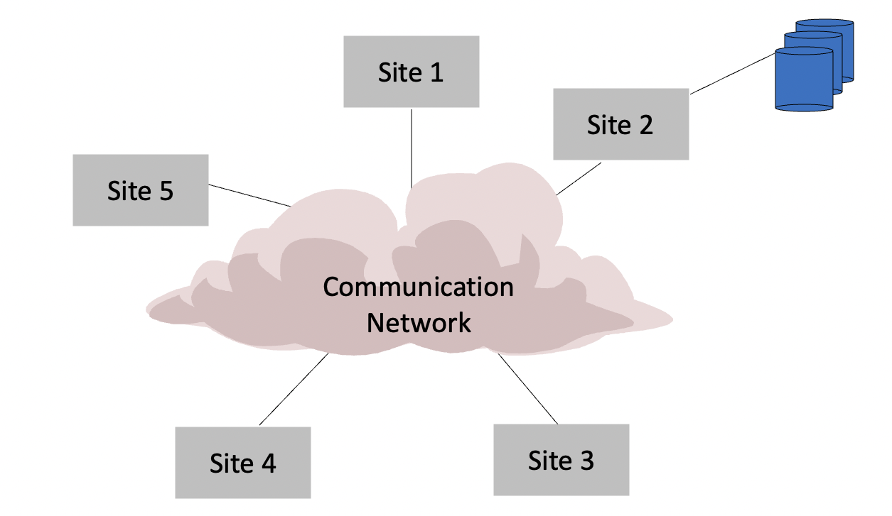
Centralized DBMS

Slide 14
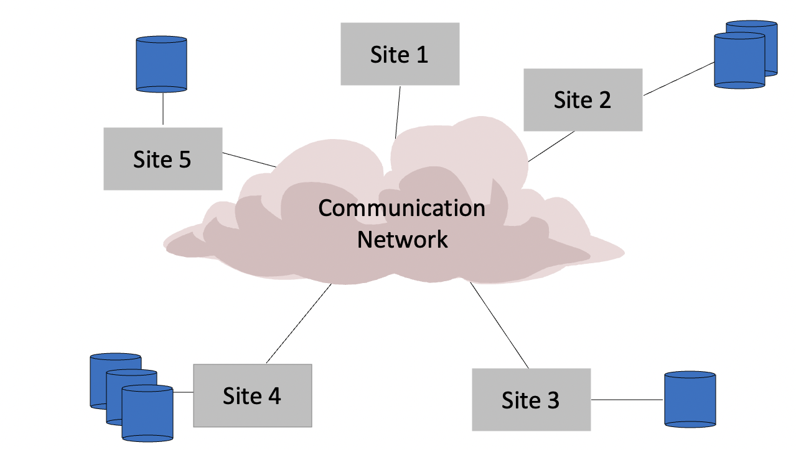
Distributed DBMS

Slide 15
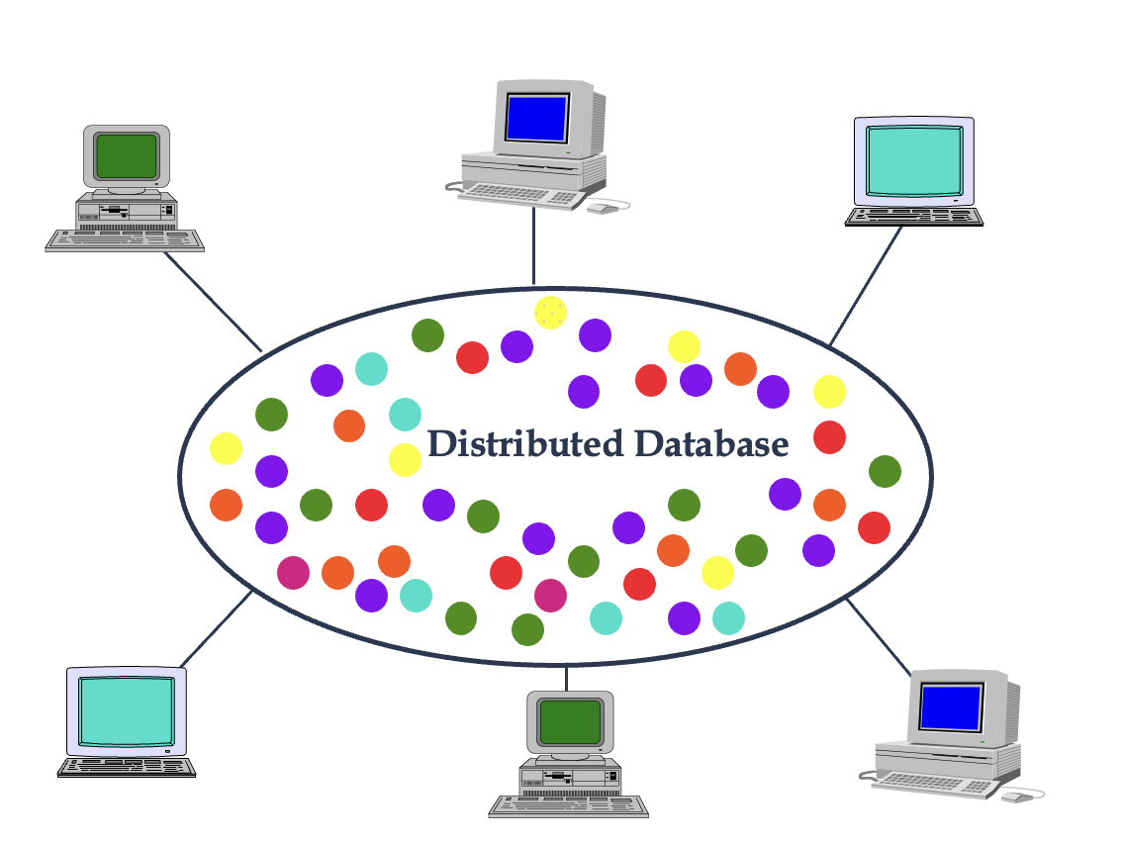
Distributed Database – User View

Slide 16
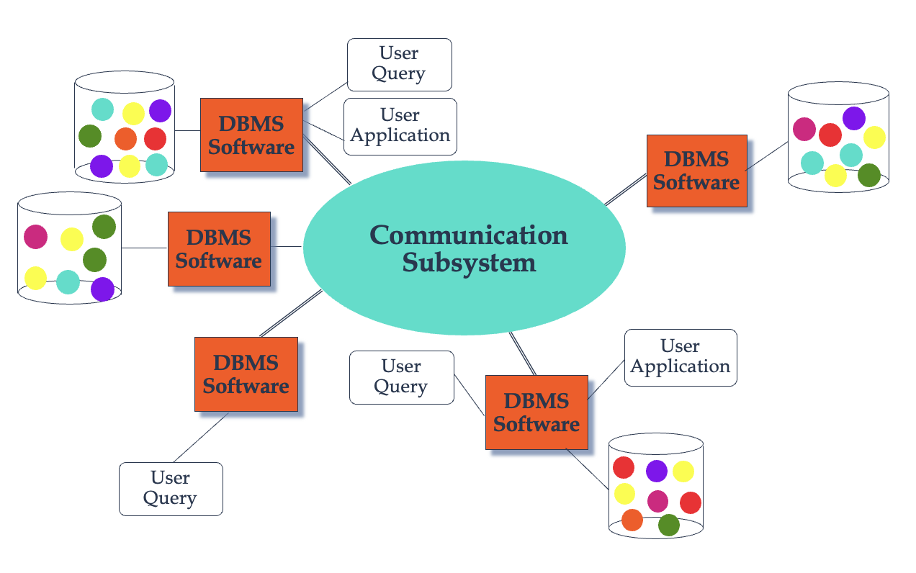
Distributed Database – Reality

Slide 17
Distributed DBMS Issues
Distributed Database Design
How to distribute the database
Replicated & non-replicated database distribution
A related problem in directory management
Query Processing
Convert user transactions to data manipulation instructions
Optimization problem
min{cost = data transmission + local processing}

Slide 18
Distributed DBMS Issues
Concurrency Control
Synchronization of concurrent accesses
Consistency and isolation of transactions' effects
Deadlock management
Reliability
How to make the system resilient to failures
Atomicity and durability

Slide 19
Parallel Computation
Asynchronous Programming

Slide 20
Process vs Threads
A process is an instance of a running program.
Process may contain one or more threads, but a thread cannot contain a process.
Process has a self-contained execution environment. It has its own memory space.
Process don't share its memory
A thread is made of and exist within a process, every process has at least one thread.
Multiple threads in a process share resources.

Slide 21
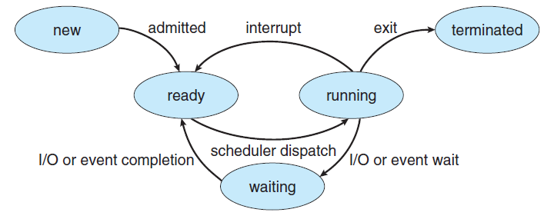
Process Life Cycle - PLC

Slide 22
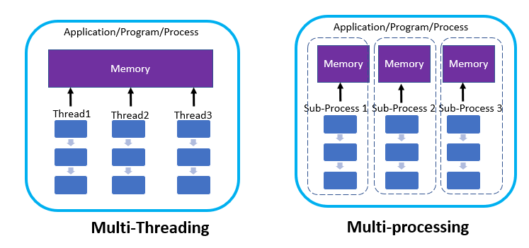
Parallel Computers
Multiprocessor/multicore: several processors work on data stored in shared memory
Cluster: several processor/memory units work together by exchanging data over a network
Co-processor: a general-purpose processor delegates specific tasks to a special-purpose processor (GPU)

Slide 23
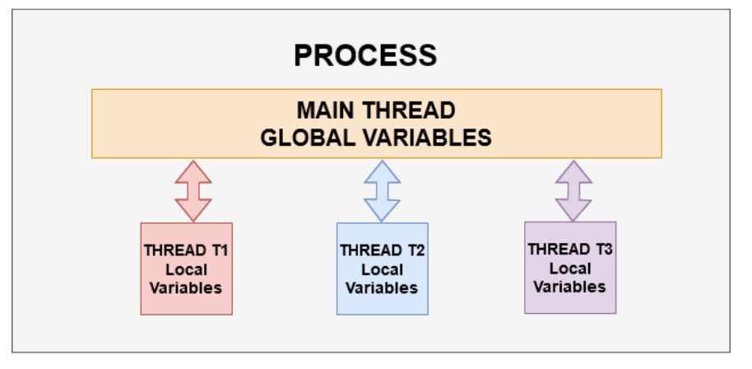
Parallel Computation
Threading allows you to have different parts of your process run concurrently. For example, A web-browser could be a process, an application running multiple cameras simultaneously could be a process.
multiple threads work together to achieve a common goal

Slide 24
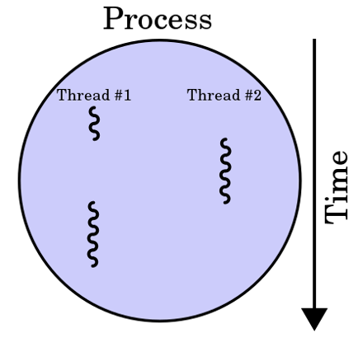
Parallel Computation
Multi-threading allows the program to speed up the execution provided that it has multiple CPUs. It also lets you perform other tasks while the I/O operations are being performed. Threads within the same process can share the memory and resources of the main thread.

Slide 25
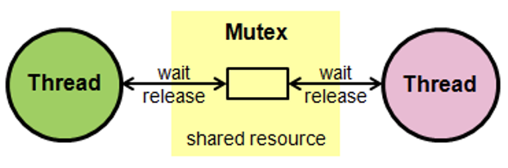
Synchronizing Threads
The threading module provided with Python includes a simple-to-implement locking mechanism that allows you to synchronize threads. A new lock is created by calling the Lock() method, which returns the new lock. It is also called “Mutex”.

Slide 26
Synchronizing Threads
The acquire(blocking) method of the new lock object is used to force the threads to run synchronously.
If blocking is set to 0, the thread returns immediately with a 0 value if the lock cannot be acquired and with a 1 if the lock was acquired. If blocking is set to 1, the thread blocks and waits for the lock to be released.
The release() method of the new lock object is used to release the lock when it is no longer required.

Slide 27
Process Hierarchies
Parent creates a child process, child processes can create its own process
Forms a hierarchy
UNIX calls this a "process group"
Windows has no concept of process hierarchy
all processes are created equal

